Slide 1
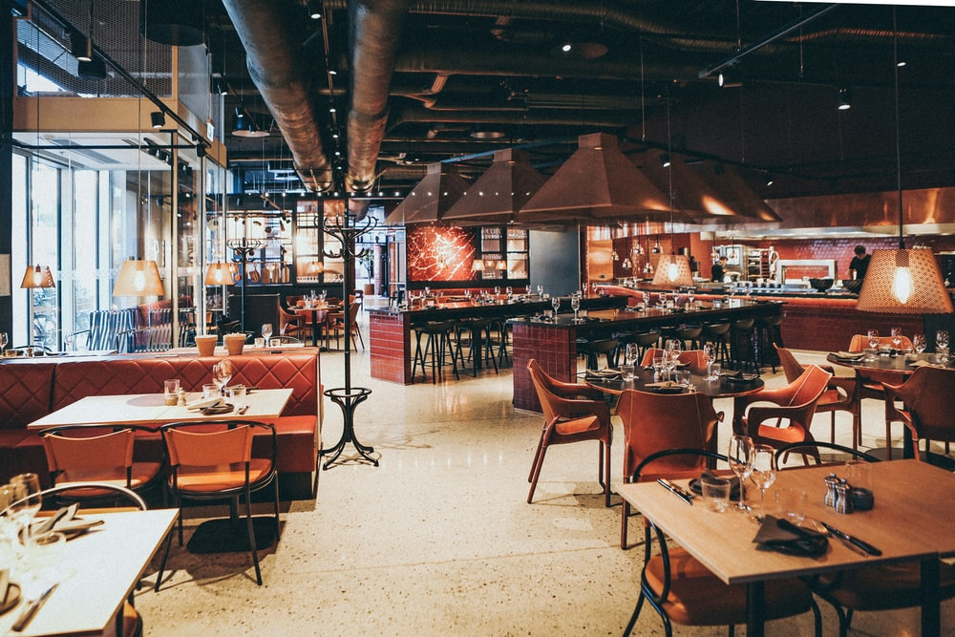
ZOMATO CASE STUDY
BY TANISHA DAS

Slide 2
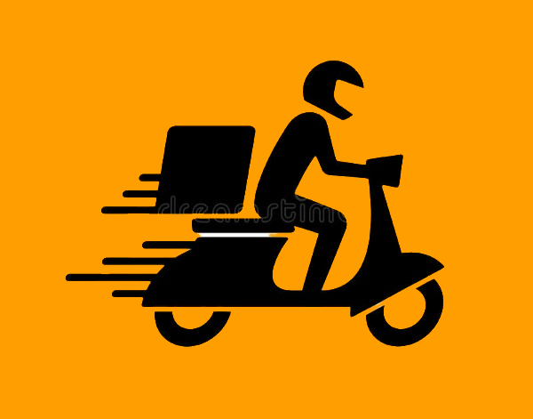
BUSINESS PROBLEM
For someone who shifted to Bangalore city for work purpose, it won’t be possible for them to prepare meals at home.
Would like to know about the restaurants that are linked with Zomato.
Bangalore, being a city with almost 12,000 restaurants serving dishes from all over the world with an increasing number of restaurants.
One would like to analyze which places and which restaurants should he/she opt for according to the purchasing power and food preferences.

Slide 3
OBJECTIVES
In Bangalore, where are the maximum number of restaurants located (Top 10 areas)?
Top 10 most famous restaurants based on average dinner ratings.
For a minimum affordable cost range of between 200-250, would like to know about the list of affordable restaurants with an average cost @200 and a dinner rating >=4.
Most famous cuisines?
For a person who is inclined towards veg dishes, would like to know top 10 areas that has the maximum number of veg restaurants.
Also, for someone who prefers eating at home rather than dining out, would like to know about the localities having most restaurants with home delivery.
For a given area, list of restaurants that are open 24 hours.
Is there any relationship between average cost and dinner ratings?
Average Cost based on dinner ratings.
Which dishes should one try when in Bangalore?
During covid times, we all would look for restaurants that are know among people for their contactless delivery. The list of top 10 restaurants based on delivery rating that has this feature.

Slide 4
DATA

Slide 5
DATA DICTIONARY
Total 19 columns
11 important columns used :
Name- Name of the restaurant
Cuisines- Cuisines offered by the restaurant
Area- City where the restaurant is located
Timing- Time duration for which a restaurant operates
IsHomeDelivery-Whether home delivery is available or not
IsVegOnly-Whether the restaurant is veg or not
Dinner Ratings- Ratings given to the restaurants
Delivery Ratings-Ratings given during delivery
PopularDishes- Dishes that are popular in the restaurant
PeopleKnownFor-For what quality it is famous among people
AverageCost – Average cost for people

Slide 6
DATA PROCESSING
Data Cleaning
Missing Value Treatment
Summarization
Pivot
Analysis
Created Charts
Derived Insights

Slide 7
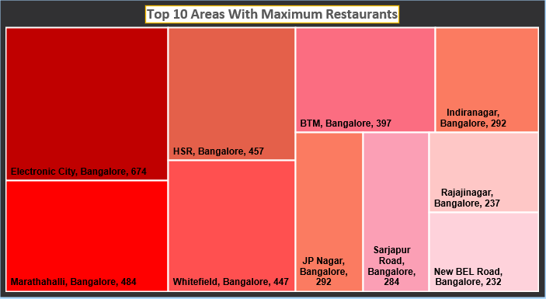
AREAS FOR A FOODIE
For a foodie who is new to Bangalore, Electronic City would be the ideal area to stay in as it has the maximum number of restaurants followed by Marathahalli.

Slide 8
AREAS
Someone who prefers veg dishes, should look for Malleshwaram as, it has the maximum number of veg restaurants followed by HSR.
If someone likes eating at home rather than dining out, Electronic City is the area that the person should look for as it has the maximum number of home delivery restaurants followed by Marathahalli.

Slide 9
RESTAURANT
Windmills Craftswork, Burma Burma, Brahmin’s Coffee Bar and CTR Shri Sagar are the few restaurants that has got the maximum dinner rating of 4.9.
During covid times, we all would look for restaurants that are known among people for their contactless delivery. The Belgian Waffle Co., NOTO-Healthy Ice Cream, Just Fresh Point, and Pizza Crunch are the restaurants with an average delivery rating of 4.4 and mostly known amongst Bangaloreans for their “Contactless Delivery”.

Slide 10
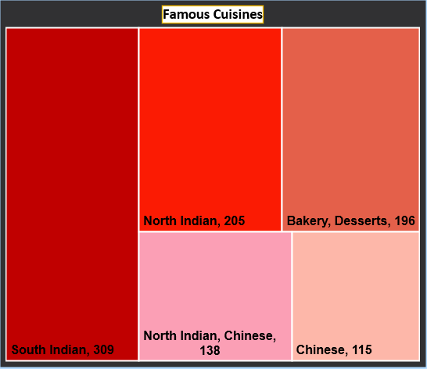
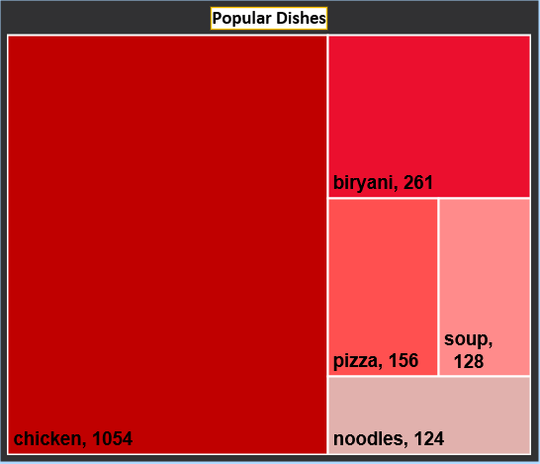
POPULAR CUISINES AND DISHES
Some of the famous cuisines are South Indian, North Indian, Bakery, Desserts, Chinese.
While staying in Bangalore, one must try dishes that has words like chicken, biryani, pizza, soup, noodles mentioned in their names.

Slide 11
RATINGS AND COST
There is a weak positive relationship between average cost and dinner ratings which indicates both are not highly dependant on each other but, as average cost increases dinner rating also tends to increase.
Also, we see that a dinner rating of 4.9 cost around 950 which is lower than what a dinner rating of 4.5 costs that is approximately 1400. This again suggests that a higher dinner rating would not necessarily costs higher.

Slide 12
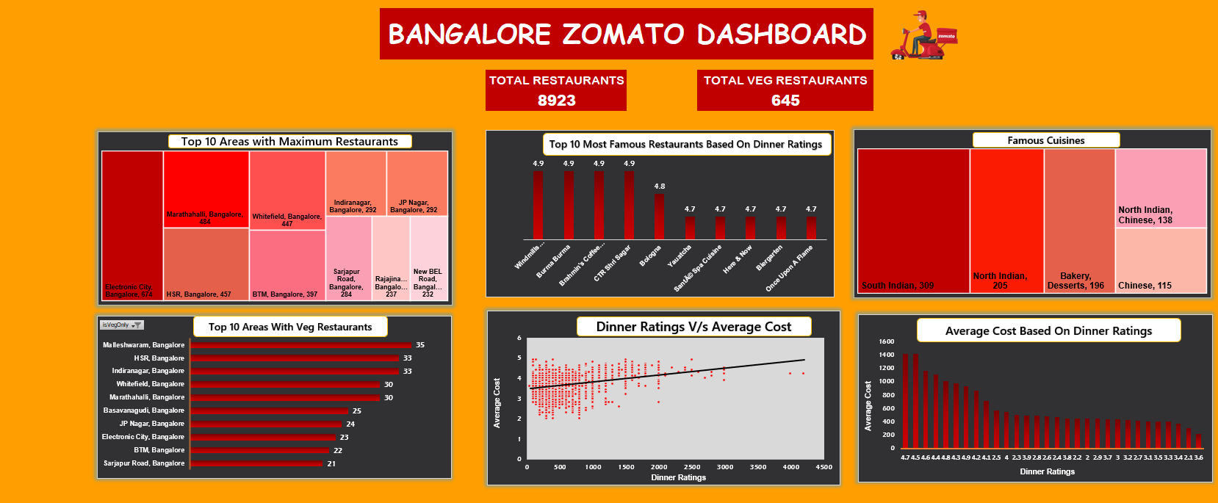

Slide 13
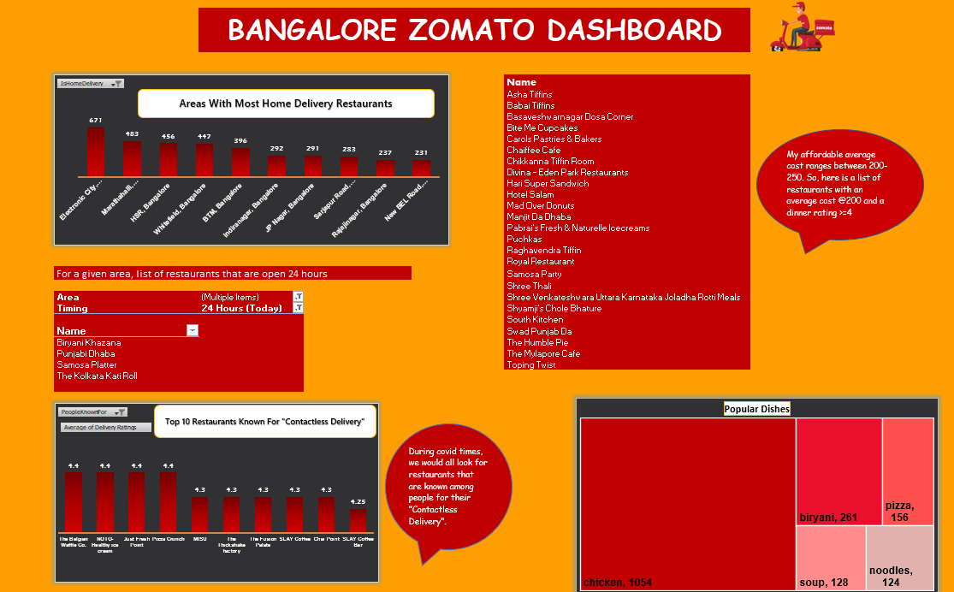

Slide 14
THANK
YOU

